Slide 1
Web Development
Module 2, Lesson 7:
Building a Web Application Client with React

Slide 2
Topics
The Basics of:
React
JSX
Babel

Slide 3
Objectives
By the end of this lesson you should be able to:
Understand the basics of React, JSX, and Babel
Build a web application client using React, JSX, and Babel

Slide 4
React Definition
What is React.js?
IT IS NOT about templates, or data binding, or DOM manipulation
IT IS about using functional programming with a virtual DOM representation to build ambitious, high performance apps with JavaScript
Notes:
Notes:
DOM—Domain Object Model
Benefits
In web development, we have a problem of keeping Uis in synch with changing data
React.js creates UIs which sync with changing data
References:
Pete Hunt: http://bit.ly/1U53Rb2

Slide 5
Defining Characteristics
Characteristics of React.js
Virtual DOM
Declarative (not imperative)
Functional
No DOM manipulation
No templates
No event listeners or handlers
Not a model-view-controller (MVC) framework/library
Only VIEW
Notes:
Notes:
React.js can work with other MVC-like frameworks such as Backbone.js and Angular.js.
React.js is often used with Flux and Meteor.
References:
https://facebook.github.io/react/docs/why-react.html

Slide 6
Why React.js??
Benefits
Developer-friendly
Easier to maintain
Easier to build complex apps
No need to learn complex language or framework conventions/features
Write less code
Faster UIs and front-end apps for users
Notes:
Notes:
Using JSX allows to write in pure JavaScript and not use HTML and not to jump between multiple files (HTML<->JS). In React, you just write in JS with JSX (optional).
React is easier to maintain because it embraces component-based architecture. It allows to build large apps by using small components.
Lots of community modules so you need to write less code, for example, material-ui.com
UIs perform faster because there’s virtual dom and smart diffing algorithm
No need to learn a new framework or a template language—just use pure JavaScript!

Slide 7
Hello World

Slide 8
Downloading React.js
Go to the React.js website
Download and install the Development (unminified versions):
<script src="https://fb.me/react-15.1.0.js"></script>
<script src="https://fb.me/react-dom-15.1.0.js"></script>
Notes:
Notes:
Development versions have warnings and better error messages.
References:
React Website: http://facebook.github.io/react/downloads.html

Slide 9
Including React in HTML
<!DOCTYPE html>
<html>
<!--Included from disk--!>
<head>
<script src="react.js"></script>
<script src="react-dom.js"></script>
</head>
<!--Hotlinked to Facebook CDN--!>
<head>
<script src="https://fb.me/react-15.1.0.js"></script>
<script src="https://fb.me/react-dom-15.1.0.js"></script>
</head>
</html>
Notes:
Notes:
Name the file: hello-world.html
Include React.js and React DOM libraries from your disk or hotlink to the Facebook CDN
Development versions have warnings and better error messages
References:
React Website: http://facebook.github.io/react/downloads.html

Slide 10
HTML Structure
<body>
<div id="example"></div>
<script type="text/javascript">
... // React.js code
</script>
</body>
</html>
Notes:
Notes:
This slide shows the <div> in the body of hello-world.html
React code must be after the div.
This div will have the mounted React elements.

Slide 11
Creating and Rendering an Object
React.createElement('h1', null, 'Hello world!’)
ReactDOM.render(React.createElement('h1', null, 'Hello world!'),
document.getElementById('example')
);
Notes:
Notes:
This JS snippet creates the h1 React.js object with content Hello world!’
Once the element is created, we render it to the DOM element with ID ‘example’)

Slide 12
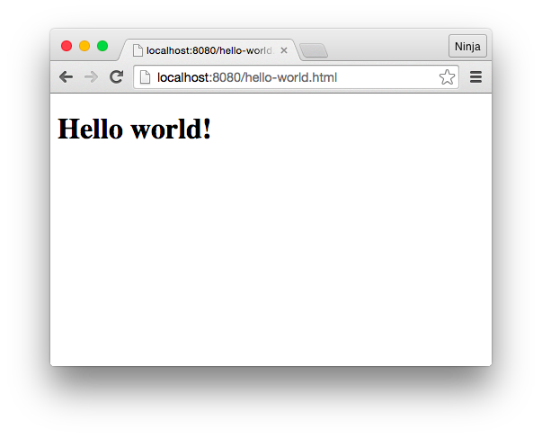
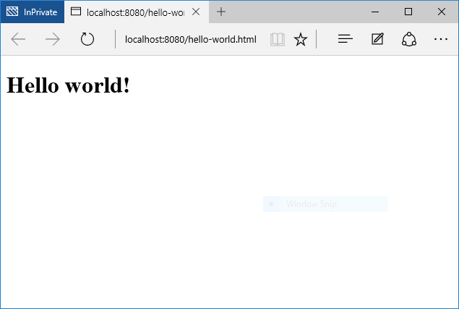
Running the Page
Open lesson7/hello-world/hello-world.html in your web browser. You should see Hello world!
Google Chrome
Microsoft Edge

Slide 13
HTML Arguments
Virtually all HTML arguments are supported so they can be passed them like this:
React.createElement("div", {style: "color:red"}, "Hello ", "world!")
//for or class attributes are called forHtml and className respectively
React.createElement("div", {className: "hide"}, "Hello world!")
React.createElement("div", {forHtml: ”hide"}, "Hello world!")
Notes:
Notes:
Many parameters can be added at the end to combine them.

Slide 14
Meet JSX

Slide 15
What is JSX
A combination of JavaScript and XML
Compiles into native/regular JavaScript
Allows for easier and faster writing HTML views and elements along with JavaScript
ReactDOM.render(
<h1>Hello world!</h1>,
document.getElementById('example')
);
Notes:
Notes:
HTML is a form of XML
References:
https://jsx.github.io

Slide 16
Why use JSX
Recommended because it provides syntax for:
Components
Layouts
Hierarchy
Notes:
Notes:
As can be seen from the previous Hello World! example, JSX is optional.

Slide 17
Ways to use JSX
Pre-process with babel-cli (production recommended)
Pre-process with a build tool like Gulp, Grunt, or Webpack (production recommended)
Run-time in-browser processing via babel-standalone (development only)
Notes:
Notes:
Babel CLI will be covered, as it is the easiest option among pre-processing ones.
Pre-processing JSX is better over run-time because it's faster.
Pre-processing is the same as compiling into native JavaScript.

Slide 18
What is Babel
Babel allows use of ECMAScript 6 now by compiling ES6 code into ES5-friendly code to support browsers that don't have ES6 yet.
Notes:
Notes:
Babel is used for a more realistic and production-like example.
This allows compiling JSX into native JS and will run only native JS in the browser.
This will increase performance in production React.js apps.
References:
https://babeljs.io/

Slide 19
Why use babel
Support for ES6 in old browsers
Good community support
A lot of other plugins (ES Next)
Already a part of the build process
React teams recommends it
Notes:
Notes:
React team discontinued their own JSX transpiler in favor of Babel

Slide 20
Installing Babel
Install Babel CLI:
Add Babel preset configurations to package.json:
Install Babel preset modules
$ npm i babel-cli@6.9.0 --save-dev
"babel": {
"presets": [
"es2015",
"react"
]
}
npm i babel-preset-es2015@6.9.0 babel-preset-react@6.5.0 --save-dev
Notes:
Notes:
If system does not have package.json, run `npm init` to create it.
Without the preset module packages, Babel won't process our JSX and it won't convert ES6/ES2015 code into ES5 one.

Slide 21
JSX Type in Script Tag
Including the normal JS code:
<body>
<div id="example"></div>
<script type="text/javascript" src="script.js"></script>
</body>
</html>

Slide 22
JSX Code
This JSX code (React.createElement to <h1>...</h1>) goes into script.jsx:
ReactDOM.render(
<h1>Hello world!</h1>,
document.getElementById('example')
);

Slide 23
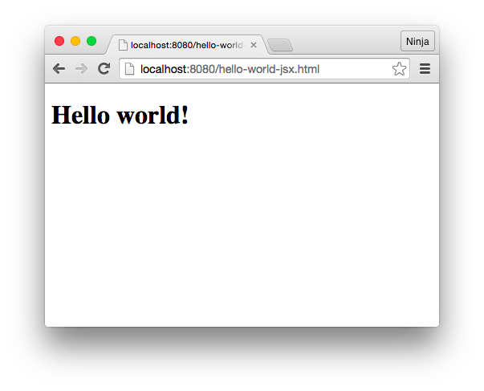
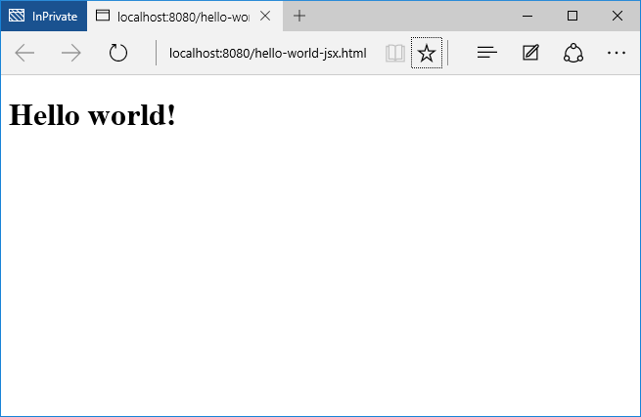
Compiling JSX with Babel CLI
./node_modules/.bin/babel hello-world.jsx –o hello-world.js -w
Google Chrome
Microsoft Edge
Notes:
Notes:
The `hello-world.js` will be created.
Leave Babel running so the `-w` can update changes automatically.
Each time ‘hello-world.jsx` is changed, the tool should update `hello-world.js` with the message: `change hello-world.jsx`.
Installing babel-cli globally is NOT recommended.
The screenshot below the command line input is what should appear when the hello-world file is opened.

Slide 24
Composable Components
The concept of components is the foundation of React.js philosophy
Components allow reuse of code and logic.
They are like templates, only better.

Slide 25
Types of React.js Components
React.js component types:
Regular HTML elements (h1, p, div, etc.)
Custom or composable components

Slide 26
Regular vs. Custom Components
Regular
Custom
If it's a regular HTML tag name, then React.js will create the element
If it is not a regular HTML tag name, then React.js will look for the custom component definition.
Notes:
Notes:
React.js uses lower-case vs. upper case to distinguish between HTML tags and components

Slide 27
Defining a Component
Composable components are created with React.createClass
var HelloWorld = React.createClass({
render: function() {
return <h1>Hello world!</h1>
}
})
Notes:
Notes:
Components must have `render` method that returns a regular component (div, h1, etc.).

Slide 28
Refactoring with a HelloWorld Component
var HelloWorld = React.createClass({
render: function() {
return (
<h1>Hello world!!!</h1>
)
}
})
ReactDOM.render(
<HelloWorld/>,
document.getElementById('example')
)
Notes:
Notes:
The hello-world-component.jsx file has a custom component.

Slide 29
Nested Elements

Slide 30
Rendering Title and Text
//Nesting h1 and p inside of div:
ReactDOM.render(
<div>
<h1>
Core React.js
</h1>
<p>This text is very useful for learning React.js.</p>
</div>,
document.getElementById('example')
)
Notes:
Notes:
Nesting React.js components is easy.

Slide 31
Single Top-Level Tag
Remember to always have only one element as the top level tag!
For example, this is a no go:
ReactDOM.render(
<h1>
Core React.js
</h1>
<p>This text is very useful for learning React.js.</p>
,
document.getElementById('content')
)
Notes:
Notes:
This is an example of BAD coding.
It needs to include the div tag

Slide 32
Nested Structures in Custom Components
var Content = React.createClass({
render: function() {
return (
<div>
<h1>
Core React.js
</h1>
<p>This text is very useful for learning React.js.</p>
</div>
)
}
})
ReactDOM.render(
<Content />,
document.getElementById('content')
)

Slide 33
Order of the Code
Remember that the content element must precede the React.js code for the getElementById method to locate the proper DOM element:
...
<div id="content"></div>
<script type="text/jsx">
var Content = React.createClass({
...
})
ReactDOM.render(
<Content />,
document.getElementById('content')
)
</script>
...
Notes:
Notes:
Content Element: `<div id="content"></div>`
React.js code: `<script ...`

Slide 34
Variables
Use {} to render variable inside of JSX ({a}, {‘ ’}, {b}):
//Output the value of a
var Content = React.createClass({
render: function() {
var a = 1
return (
<div>
<h1>
{a}. Core React.js
</h1>
<p>This text is very useful for learning React.js.</p>
</div>
)
}
})

Slide 35
States
States are mutable properties of components (can change)
When state changes, the corresponding view changes
Everything else in DOM remains intact

Slide 36
Initial State
The initial state is set by the getInitialState method which is called once when the element is created
//Here we call the getInitialState method to return a
var Content = React.createClass({
getInitialState: function(){
return {a: 0}
},
...

Slide 37
Updating and Outputting State
//Updating:
var Content = React.createClass({
getInitialState: function(){
var _this = this
setInterval(function(){
_this.setState({a: Math.random()})
}, 300)
return {a: 0}
},
…
//Outputting:
render: function() {
return (
<div>
<h1>Changing the State</h1>
<p>This value is random: {this.state.a}</p>
</div>
)
}
})
Notes:
Notes:
State is updated with this.setState.
The Updating code will update the value with a random number every 300 milliseconds.
To output the state property a, use {this.state.a}
Rendering
The rendering didn't change:
ReactDOM.render(
<Content />,
document.getElementById('content')
);

Slide 38
Component Methods

Slide 39
Calling Methods
//It's possible to invoke components methods from the `{}` interpolation:
var Content = React.createClass({
getA: function(){
return 10
},
render: function() {
return (
<div>
<p>This value is return by the method: {this.getA()} </p>
</div>
)
}
})
...

Slide 40
Component Events

Slide 41
Why we need events?
Without events the UIs are just static HTML.

Slide 42
Events
Components have normalized (cross-browser) events
Declare events in the JSX and classes:
var Content = React.createClass({
getInitialState: function(){
return {counter: 0}
},
click: function(e){
this.setState({counter: ++this.state.counter})
},
...
Notes:
Notes:
Some Cross-Browser events:
onClick onContextMenu onDoubleClick onDrag onDragEnd onDragEnter onDragExit
onDragLeave onDragOver onDragStart onDrop onMouseDown onMouseEnter onMouseLeave
onMouseMove onMouseOut onMouseOver onMouseUp
React.js is declarative, not imperative.
Events are not attached like would be done with jQuery, instead they are declared in the JSX and classes

Slide 43
Button onClick Event
The button has the onClick={this.click}
The name must match the method of the Content component class:
...
render: function() {
return (
<div>
<button onClick={this.click}>Don't click me {this.state.counter} times!</button>
</div>
)
}
})

Slide 44
Props
Props or properties are immutable (don't change)
Passed by parent components to their children
var ClickCounterButton = React.createClass({
render: function() {
return <button onClick={this.props.handler}>Don't click me {this.props.counter} times! </button>
}
})

Slide 45
Supplying Props
//Provide props to the ClickCounterButton component:
var Content = React.createClass({
getInitialState: function(){
return {counter: 0}
},
click: function(e){
this.setState({counter: ++this.state.counter})
},
render: function() {
return (
<div>
<ClickCounterButton counter={this.state.counter} handler={this.click}/>
</div>
)
}
})
...

Slide 46
Where to Put Logic
In this example, click event handler was in the parent element.
Let's create a button:
var ClickCounterButton = React.createClass({
render: function() {
return <button onClick={this.props.handler}>Don't click me! </button>
}
})
Notes:
Notes:
The event handler can be put on the child itself, but using parent allows exchange of info between children components.

Slide 47
Exchanging Props between Children
This is a new component which displays the value prop:
var Counter = React.createClass({
render: function(){
return <span>Clicked {this.props.value} times.</span>
}
})

Slide 48
Parent Component
//The parent component provides props one of which is a handler:
var Content = React.createClass({
getInitialState: function(){
return {counter: 0}
},
click: function(e){
this.setState({counter: ++this.state.counter})
},
render: function() {
return (
<div>
<ClickCounterButton handler={this.click}/>
<br/>
<Counter value={this.state.counter}/>
</div>
)
}
})

Slide 49
componentDidMount
Invoked when component is inserted into the DOM
Use to perform operations, and/or send AJAX/XHR requests
//Print DOM:
var Content = React.createClass({
componentDidMount: function(e){
// Make AJAX/XHR request
// Update state
console.log(ReactDOM.findDOMNode(this))
},
render: function() {
return (
<div/>
)
}
})

Slide 50
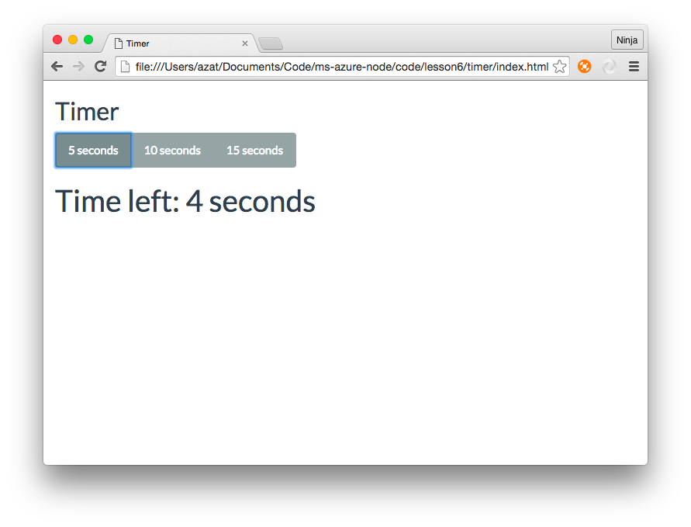
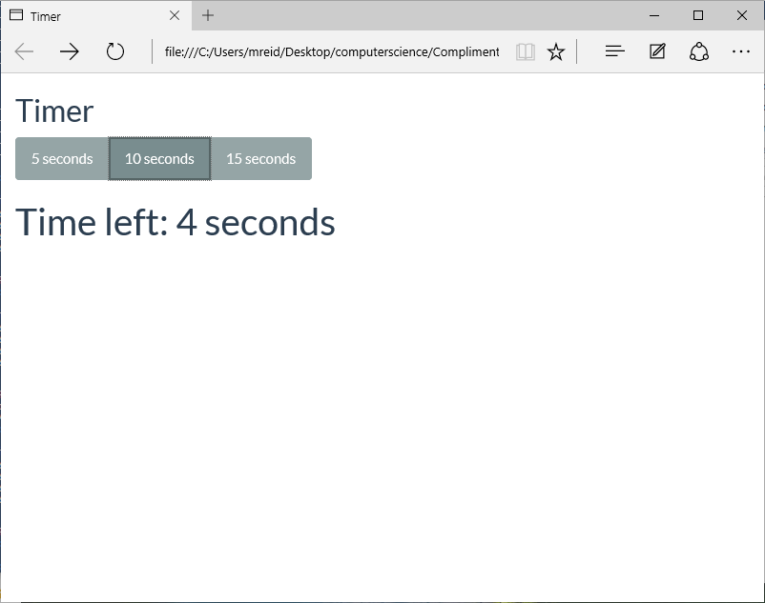
Timer
Google Chrome
Microsoft Edge
Notes:
Notes:
Show the Timer app in action
code/lesson6/timer
Walk through the solution highlighting three components and all the logic is in the main parent component and not in its children.
References:
https://github.com/azat-co/cheatsheets/tree/master/react

Slide 51
Summary
In this lesson, you have learned
The basics of React, JSX, and Babel
How to build a web application client using React, JSX, and Babel
Notes:
Notes:
The Module 2 Lesson 7 Lab should be competed at this time
https://github.com/MSFTImagine/computerscience/blob/master/Complimentary%20Course%20Content/Module2/Labs/Module%202%20Lesson%207%20Lab.docx

